Slide 1

Coach’s Perspective:
First Steps Towards Spreading & Sustaining
Sonya Sullivan
Community Learning Session #4
March 4, 2016

Slide 2
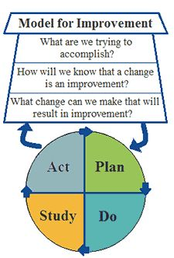
Model for Improvement
Simple yet powerful tool
It makes sense
We will have a man on the moon in 10 years. Classic example of an Aim Statement
Who my team is and what are we trying to do today.
  Mary Picariello
  Janet DaCosta
  Sandra DeFrancisco
  Carla Piva
  Denise Castucci
  JoAnn Chesley
  Lindsey Moscato
Notes:
1. What are we trying to change 2. What is our baseline date 3. Did we see the change we wanted to make

Slide 3
Practices
Mount Auburn Medical Associates
Waverley Primary Care
Cambridge Medical Associates
Watertown Primary Care
Mount Auburn Healthcare at Waltham
Mount Auburn Healthcare at Cambridge
Mount Auburn Healthcare at Medford
Quimby Center for Geriatric Care

Slide 4
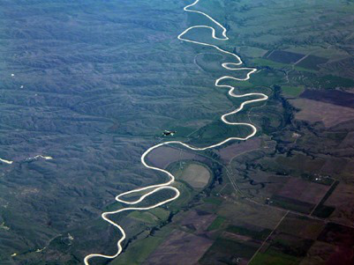
Challenges We Faced
Getting started
Selecting improvement project
Aim Statement
Scheduling regular meetings
Getting baseline data
Patient engagement
Notes:
Getting started: Education/ on line courses/ selecting the team/ making time in busy schedule. Biggest challenge was gathering baseline data.

Slide 5
Impact on Patient Safety
How has Patient Safety been impacted?
  Understanding Our Patients
  Baseline Data
  Changing Systems (Epic)
Patient/Manager Stories
  Reduced Anxiety
  Improving Patient Experience
  Closed the Loop

Slide 6

Impact on Efficiency and Sustaining the Change
PDSA
Reports
Workflow Changes
Huddles/Care Coordination
Best Practice
Patient Engagement
Desire for Change
Staff Joy
Systems Change (Epic)

